Slide 1
ESG Targeting Impacts and Tradeoffs
Nature of Target | Low for Long | High for Long | Negative Yields – Frequency and Magnitude | Inversion Frequency
Mean Reversion Speed | Slower = Higher Probability | Slower = Higher Probability | Slower = Higher Probability | Slower = Higher Probability
Volatility | Higher = Higher Probability | Higher = Higher Probability | Higher = Higher Probability | Higher = Higher Probability
Shift Parameter | Higher = Lower Probability | Higher = Higher Probability | Higher = Lower Probability | Minimal
Shape Parameters | Steeper = Lower Probability | Steeper = Lower Probability | Steeper = Higher Prob. for Short Yields, Lower for Long Yields | Steeper = Lower Probability
Mean Reversion Parameter (MRP) | Minimal* | Minimal* | Higher = Lower Probability | Minimal
Term Premiums | Minimal** | Minimal** | Larger = Higher Probability | Larger = Lower Probability
* Assumes that “Low” and “High” are defined relative to the MRP. For example, in these slides, we’ve taken “Low” as being below MRP – 2.0% (i.e. 1.5%)
** Assumes that the “Low” and “High” calculations are based on the 20-Year Yield

Slide 2
Nature of Target – Detailed Discussion
Nature of Target | Parameter(s) | Discussion
Mean Reversion Speed | 1 / (Kappa – Lambda1)* | In the stochastic equation for the State variables (page 3 of the NAIC Technical Documentation Interest Rates DRAFT on Conning’s website), we see that the current state variable X is multiplied by (Lambda1 – Kappa). Since this quantity MUST be negative, we will see faster reversion when Kappa – Lambda1 is large. Conversely, the closer it is to zero, the slower the State variable will revert.
𝑑$X_{i}$(𝑡) = (${\text{θ}}_{i}$ + ${\text{λ}}_{i}^{0}$ + (${\text{λ}}_{i}^{1}$− ${\text{κ}}_{i}$)$X_{i}($𝑡))𝑑𝑡 + ${\text{σ}}_{i}\sqrt{X_{i}(\text{t}\text{)}}$ 𝑑$W_{i}$(𝑡)
Notes:
* By State Variable

Slide 3
Nature of Target – Detailed Discussion
Nature of Target | Parameter(s) | Discussion
Volatility | Sigma* | In the stochastic equation, the first part of the term is a fixed drift based on the current State variable. The second part controls the volatility with Sigma being the main driver. Since the square root of the State variable is also in that formula, all of the other parameters will impact this, as well. But, they are secondary to the impact of Sigma.
𝑑$X_{i}$(𝑡) = (${\text{θ}}_{i}$ + ${\text{λ}}_{i}^{0}$ + (${\text{λ}}_{i}^{1}$− ${\text{κ}}_{i}$)$X_{i}($𝑡))𝑑𝑡 + ${\text{σ}}_{i}\sqrt{X_{i}(\text{t}\text{)}}$ 𝑑$W_{i}$(𝑡)
Notes:
* By State Variable

Slide 4
Nature of Target – Detailed Discussion
Nature of Target | Parameter(s) | Discussion
Shift Parameter | L(0) | In the GEMS Model, there is a shift function that has two roles. First, it allows the Yields to go negative. Second, it is used to fit the initial curve. The first element of this vector (i.e. L(0)) is fixed as part of the calibration process.

Slide 5
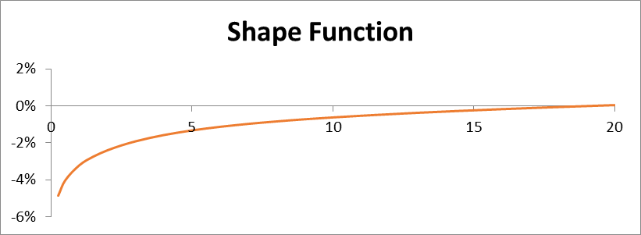
Nature of Target – Detailed Discussion
Nature of Target | Parameter(s) | Discussion
Shape Parameters | Theta and Kappa* | To convert the State variables into Spot Rates, the GEMS Model uses two auxiliary functions which are based on the Risk-Neutral parameters (i.e. Theta, Kappa and Sigma) and the desired Tenor. One is a variable component (i.e. it gets multiplied by the simulated State variables throughout the simulation). The second only varies by Tenor (see below). For these parameters, “Steeper” means that this fixed curve is more sloped. That can happen if either Kappa decreases or Theta increases. Sigma has a minimal impact.
Notes:
By State Variable
Some of the impacts in the table are indirect for this item. For example, steepening this curve will increase the probability of High for Long scenarios. However, when that change happens, it usually means that the variable component is also steeper (i.e. tends towards 0 faster). This will lead to long-tenors, like the 20-Year Yield that is used in the High for Long calculation, to become less volatile. This drop will tend to more than offset the increase from the original steepening. So, at the end of the process, you will tend to end up with fewer High for Long scenarios.

Slide 6
Nature of Target – Detailed Discussion
Nature of Target | Parameter(s) | Discussion
Mean Reversion Parameter (MRP) | Lambda0* | In the stochastic equation, the long-term mean for the State variable will occur when the drift term is zero. Specifically, LT State = (Theta + Lambda0) / (Kappa – Lambda1). Since all of the other variables impact multiple items (e.g. Kappa and Lambda1 also impact the Mean Reversion Speed), adjusting to the MRP will largely be accomplished by adjusting the Lambda0 values.
Term Premiums | Lambda0* | Since the Long-Term Yield Curve is based on all 3 State variables, changes in either the 1-Year vs 20-Year and/or 3-Month vs 1-Year Term Premiums will also be largely linked to changes in the Lambda0s.
𝑑$X_{i}$(𝑡) = (${\text{θ}}_{i}$ + ${\text{λ}}_{i}^{0}$ + (${\text{λ}}_{i}^{1}$− ${\text{κ}}_{i}$)$X_{i}($𝑡))𝑑𝑡 + ${\text{σ}}_{i}\sqrt{X_{i}(\text{t}\text{)}}$ 𝑑$W_{i}$(𝑡)
Notes:
* By State Variable

